Slide 1

Consulting Report
Team 13: Anika Abrahamson, Chelsea Alford, Joe Werthan, Karry Lu, Lisiman Hua
Notes:
parent company: Aldi

Slide 2
Executive Summary
Should Trader Joe’s expand into the online grocery industry?
Trader Joe’s strength is in it’s uniquely pleasant but inconvenient shopping experience which creates a feeling of scarcity. This strength will not translate into the online grocery segment. An attempt to enter the fiercely competitive online grocery segment will likely reduce Trader Joe’s strength and overall position in the grocery industry.

Slide 3
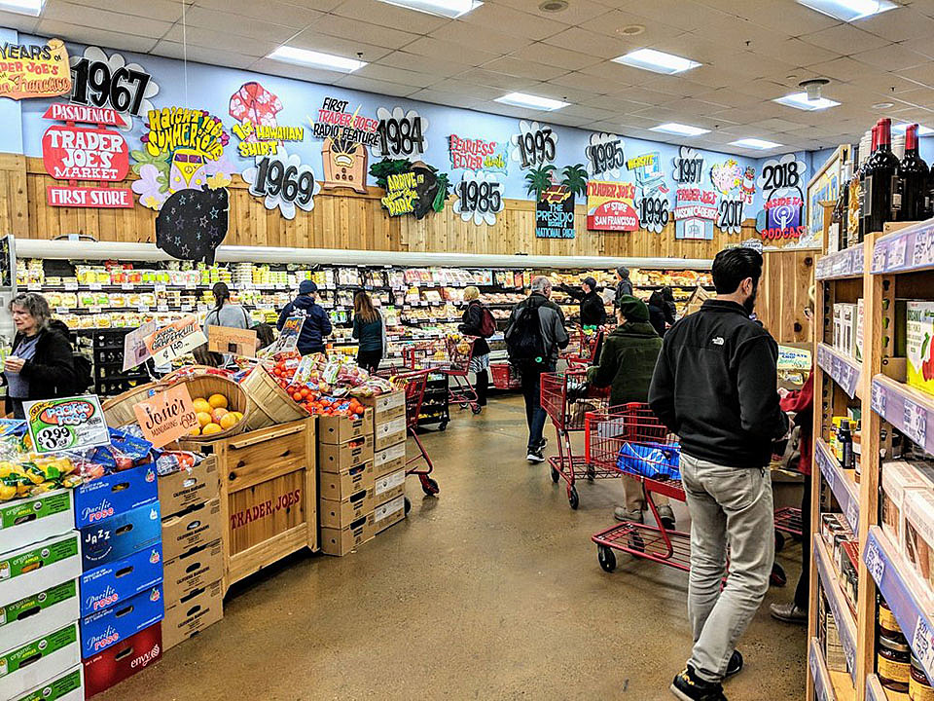
Trader Joe’s in the Grocery Industry

Slide 4
Grocery is a highly competitive industry.
Competitors: Kroger, Whole Foods, Safeway, Sprouts
Environmental Analysis:
Porter’s Five Forces - Grocery Store:
Socio-Cultural | Healthier food trends Rising demand for grocery delivery
Technological | Application of analytics Digital Marketing and CRM
Macro-Econ | Slow wage growth: searches for low prices
Global Trade | Availability of global products Supply chain complexity Wide range of supplier resources
H
Threat of New Entrants
H
Threat of Rivalry
H
Threat of Buyer Power
L
Threat of Supplier Power
H
Threat of Substitutes
Notes:
See appendix slide 17 for further analysis.

Slide 5
Trader Joe’s is set apart from the rest of the industry.
Other Grocery Stores In The Industry Value
Trader Joe’s
Separation from Industry
- Major Brands | - Coupons
- Quick Checkout | - Large Stores
- Online offerings
- Private Label Products | - Low Prices with no coupons or sales
- Small Stores | - Unique Staff
- Cult Following
Notes:
Sources:
https://www.npr.org/2019/05/09/721829024/how-some-manufacturers-secure-store-display-spots-to-crush-competition
https://progressivegrocer.com/shoppers-more-interested-trader-joes-private-label-any-other-retailers
https://www.supermarketnews.com/center-store/private-label-trader-joes
https://www.youtube.com/watch?v=Q_QPClXo5MU
https://www.supermarketnews.com/online-retail/online-grocery-more-double-market-share-2025

Slide 6
Should Trader Joe’s Enter the Online Grocery Segment?

Slide 7
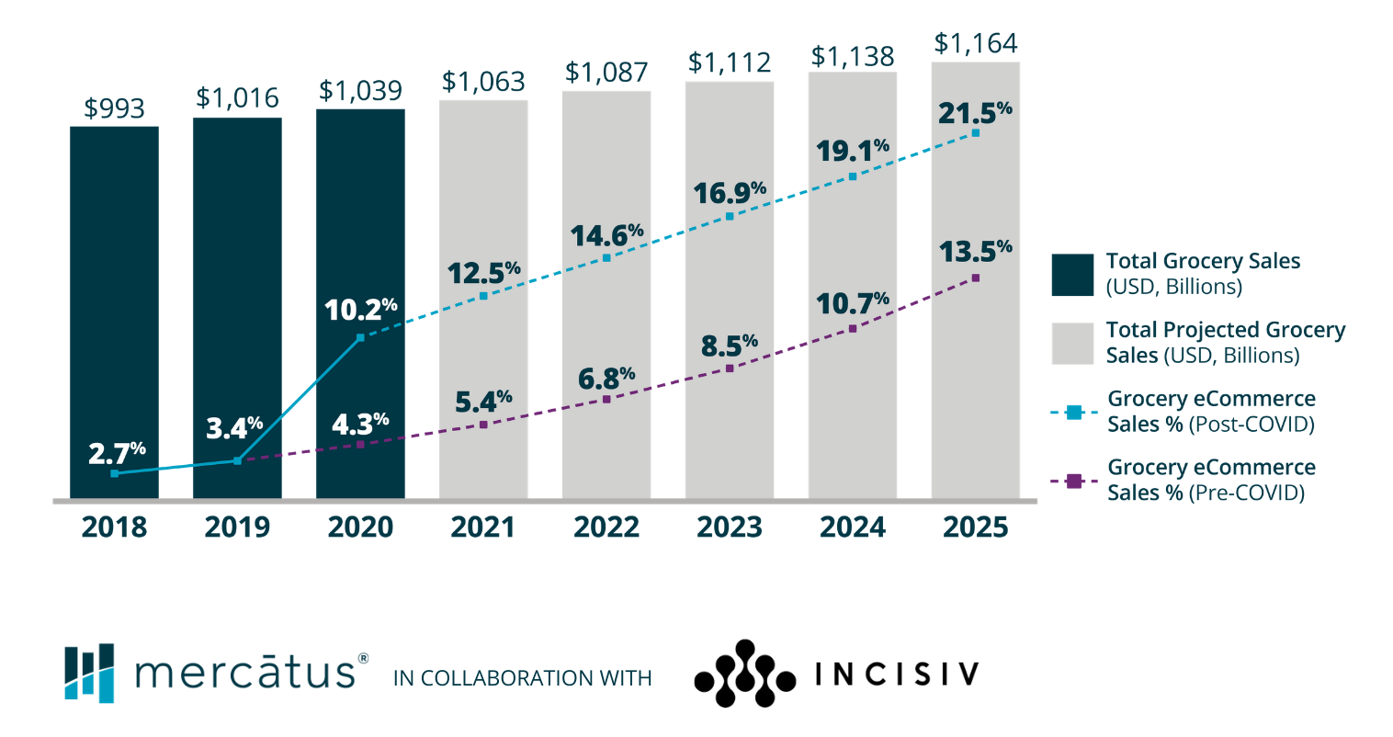
Is E-Grocery the future of the food retail industry?
Online grocery is expanding constantly and seems like the future of food retail industry
COVID-19 disruptions have accelerated the growth of online grocery and fundamentally changed consumers’ shopping behaviors
Notes:
See appendix slide 18 for further analysis and sources.

Slide 8


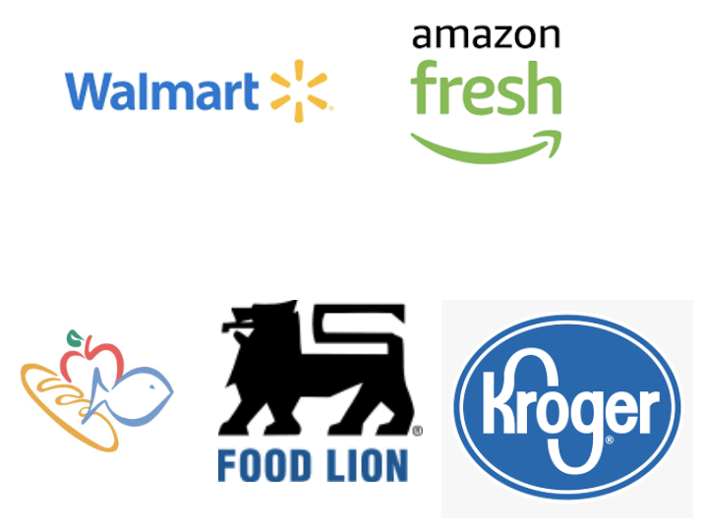
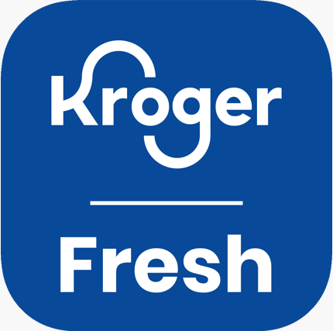
There is increasing demand for Trader Joe’s online service.
Constantly increasing demand
Convenient and time-saving
Online arbitrage has long been a problem for Trader Joe’s
People are requesting multi-channel services from Trader Joe’s
Top competitors in food retail industry have already adopted to online service
Online services app logos of Trader Joe’s main competitors
Notes:
See appendix slide 19 for further analysis and sources.

Slide 9
Analysis

Slide 10
Trader Joe’s combines its strengths and weaknesses to create a cult following and unique shopping experience.
Internal Strengths
External Opportunities
Cult following from unique products and feeling of scarcity ¹
Online shopping, pickup, or delivery ²
SWOT
Internal Weaknesses
External Threats
Inconvenience due to small stores with limited product offerings ³
Threat of imitation (Trader Joe’s strength is in its unique shopping experience, if it cannot remain singular, it will likely lose much of its appeal)
Notes:
See appendix slide 20 for full SWOT analysis.
1
https://www.businessinsider.com/trader-joes-stores-deals-hacks-secrets-2018-5#packaging-isnt-important-to-the-chain-1
2
https://www.supermarketnews.com/online-retail/online-grocery-more-double-market-share-2025
3
https://slate.com/human-interest/2016/02/the-ultimate-trader-joes-shopping-hack-dont-shop-at-trader-joes.html

Slide 11
The unique shopping experience of Trader Joe’s is valuable, rare, inimitable, and difficult to substitute for.
Perception of scarcity drives sales and reduces costs
Competitors attract customers with the feeling of abundance and the promise of convenience
Value
Rare
VRIN
Incumbents cannot imitate due to established reputations with customers
New entrants face challenges capturing the causal ambiguity of Trader Joe’s shopping experience
Competitors who can successfully tie their brand to their shopping experience may capture similar value
Inimitability
Non-substitutability
Notes:
See appendix slide 21 for further analysis and sources.

Slide 12
Environment
Fun/Interactive culture
Small stores/aisles
Knowledgeable Staff
Simulated Scarcity
Exclusivity
Want to be there
Owns Private Label
Energetic/Outgoing
No Coupons/Sales
What creates Trader Joe’s value is its in-store experience.
Well Trained/Paid
No Availability Guarantees
In-store Experience
Limited Selections
No Office/
Always on the Floor
High Quality/
Low Prices
Educated/
Willing to
Experiment
Relocate Managers
Vertical Supply Integration
Only Promote from Within
Variety of Products
Management
Slow Store Growth
Cult-like Following
Customer Base
Notes:
Activity System Analysis
Combination of obvious capabilities and connection of related factors
Removing any capability would lessen the strength of the other capabilities
Difficult for competitors to copy the entire business model
Shifting to online delivery would damage multiple aspects of the current in-store model
What creates Trader Joe’s value is its in-store experience. This unique value is not just in the combination of the more obvious factors (the outside), but also the combination of the features that those factors create (on the inside). The business model is greater than the sum of its parts and removing any piece significantly lowers the synergy of the whole system. Just as a competitor could not just copy any one of the facets and get the same value, Trader Joe’s could not retain the same value by removing any of the facets either. Adding the service of online could damage the current model that Trader Joe’s has and harm the synergy that the connected capabilities have created.

Slide 13
Online grocery is not a desirable industry segment to enter.
Porter’s Five Forces - Online Grocery:
H
Threat of New Entrants
H
Threat of Rivalry
Face fierce competition and threats in all five forces
H
Threat of Buyer Power
H
Not wise for TJ to enter the online grocery industry
Threat of Supplier Power
H
Threat of Substitutes
Notes:
See appendix slide 23 for further analysis.
https://www.businessinsider.com/online-grocery-report-2020
https://www.case48.com/porter-case/18983-AmazonFresh-Rekindling-the-Online-Grocery-Market
https://www.bloomreach.com/en/blog/2020/01/challenges-online-grocery-business.html
https://www.fatbit.com/fab/challenges-faced-online-grocery-businesses-and-their-solutions/

Slide 14
Recommendation

Slide 15
We recommend Trader Joe’s should not provide online delivery.
Despite the large market growth and potential, online delivery does not add any value
Trader Joe’s core capability is the in-store shopping experience for its current customers
Unclear what Trader Joe’s could provide to online customers that competitors do not
Going online would decrease Trader Joe’s performance
Trader Joe’s parent company (Aldi) already has an online delivery offering

Slide 16
Appendix

Slide 17
Industry Overview
Industry Identification: Grocery Stores
Existing Players: Trader Joe’s, Kroger, Whole Foods, Safeway, Sprouts
Environmental Analysis:
Porter’s Five Forces:
Demographic | Suburbs and cities are more populous than rural America
Socio-Cultural | Healthier food trends Rising demand for grocery delivery
Technological | Increased analytics and technology implementation for inventory management, digital marketing and sales
Macro-Econ | Stagnant wage growth leads to searching for lower prices
Political-Legal | Food stamps/government aid Food safety and USDA recalls Alcohol sale laws and liquor licenses
Global Trade | Availability of global products Trade conflicts incur increased tariffs on imported goods
H
Low entry barrier for new stores or franchise
Easy to append grocery segment to existing stores
Threat of New Entrants
H
Threat of Rivalry
Highly fragmented
Perishable and homogeneous products
Slow growing industry
H
Threat of Buyer Power
Low product differentiation
High impact of Food & Beverage on budgets
Delivery service expansion
L
Threat of Supplier Power
Suppliers compete for shelf space
Suppliers depend on grocery stores to sell their products
H
High substitutes availability
High price competitiveness
Low switching cost
Significant target group overlap
Threat of Substitutes

Slide 18
Is E-Grocery the future of the food retail industry?
Online Grocery expanding constantly
Market share expected to be doubled to reach 21.5% by 2025¹
Sales in US is expected to grow to 250 billion USD by 2025²
Top competitors in food retail industry have already move into the field
52.2% grocery stores now offers home delivery, in-store pickup, or curbside pickup³
COVID-19 disruption accelerates the growth of online grocery and fundamentally change consumers’ shopping behaviors
Several studies indicate >35% shoppers increase online grocery shopping due to COVID-19^{2,4}
~90% of current online shoppers are expected to stay with online services post-pandemic²
online adoption will continue to grow²
Notes:
https://www.statista.com/statistics/531189/online-grocery-market-share-united-states/
https://info.mercatus.com/egrocery-shopper-behavior-report?utm_source=ketner&utm_medium=media&utm_campaign=fy21-q3-shopper-survey-report-ketner-press-release
https://www.statista.com/statistics/762746/store-share-online-grocery-delivery-store-pickup-services/
https://www.statista.com/statistics/1104947/spending-on-goods-from-online-marketplaces-coronavirus-us/

Slide 19
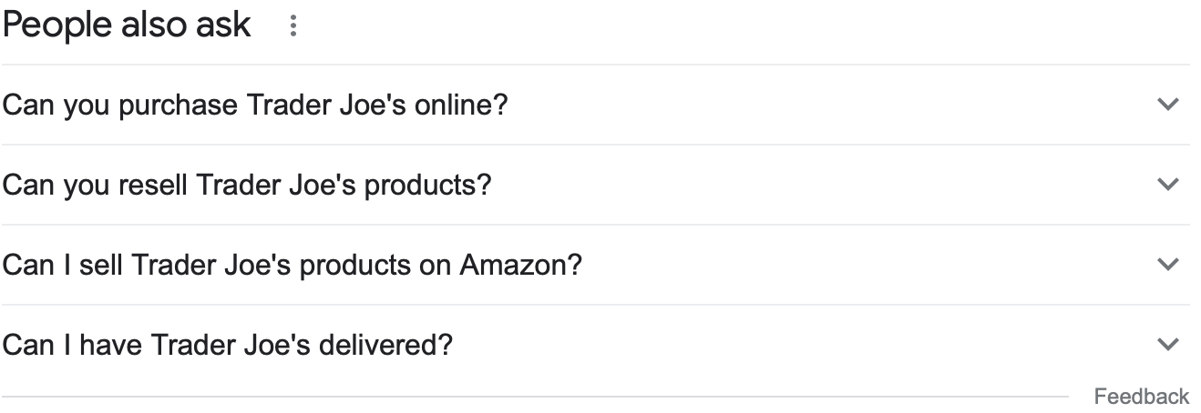
There is increasing demand for Trader Joe’s online service.
Online Grocery seems like the future of food retail industry
Growing market
Main competitors have all adapted to online services
In 2020, Walmart alone generates 21.5 billion UCD revenue from e-commerce in the US¹
Constant demand
Convenient and time-saving
Online arbitrage has long been a problem
Couple made $30,000 from reselling Trader Joe’s products online in 2019²
People are requesting online services from Trader Joe’s
Online services app logos of Trader Joe’s main competitors
Notes:
https://www.statista.com/statistics/1109330/walmart-ecommerce-sales-by-division-worldwide/
https://www.thekitchn.com/trader-joes-retail-arbitrage-herbert-267222

Slide 20
Internal Strengths – cult following
External Opportunities – What others do
strong brand -> high customer loyalty
low prices & no sales -> high value perception
frequently updating inventory, feeling of scarcity -> impulse buying
pleasant shopping experience (friendly staff, new “discoveries”, small store, limited choices, etc.)
small store, crowded, long lines, crowded parking lots -> all lead into the feeling of scarcity and uniqueness
intentional staff (friendly, well-trained, etc.)
online grocery shopping, grocery pick up / delivery
expansion: develop more in-house brands (further backward integration)
expansion: open new stores
add more “grocery store” features like a deli or a pharmacy
utilize sales, coupons, or a loyalty program
SWOT
Internal Weaknesses – inconvenient
External Threats – Different from competitors
small store -> cramped aisles, crowded, long lines, crowded parking lots, etc.
inconvenient -> no pick-up or delivery, don’t have everything you need, don’t have big brands, might stop carrying something you like
not good at “being a grocery store” -> buying in bulk to drive down costs can lead to sooner expiration dates
threat of competitors taking away customers due to convenient services like delivery or loyalty programs
threat of imitation (Trader Joe’s strength is in its unique shopping experience, if it cannot remain singular, it will likely lose much of its appeal)
importance of relationship with suppliers
increase of organic offerings elsewhere

Slide 21
VRIN Analysis of the Unique Shopping Experience of Trader Joe’s
Value
Rare
Limited product offerings reduce inventory cost
Private label products:
Cheaper to produce than competitors branded products
Reduce buyer power
Raise perception of value and scarcity
Fewer locations coupled with small stores reduces operating cost and increases perception of value and scarcity
Competitors attract customers with the feeling of abundance (with products, and locations), not scarcity
Competitors attempts at backward integration have not been received as well with customers
Customer loyalty is higher than with competitors
Competitors cater to the customer perception of grocery shopping as a chore, adding service features to make the shopping experience more convenient, not pleasant
Inimitability
Non-substitutability
Competitors can imitate, but they won’t
Customers expect competitors to offer certain products and brands, requiring competitors to have a large variety of products
Competitors would face difficulty sourcing new suppliers and severing existing supplier relationships
Imitators face challenges of capturing the causal ambiguity of the pleasant shopping experience
Competitors offering any one aspect of the Trader Joe’s shopping experience, like low prices, fail to capture the value of the pleasant shopping experience
Neighborhood grocery stores act as substitutes only on a small, local scale
Competitors who can successfully tie their brand to their shopping experience may capture similar value
Notes:
Value
https://www.youtube.com/watch?v=Q_QPClXo5MU
https://www.businessinsider.com/trader-joes-sales-strategy-2014-10
Rare
https://byronsharp.wordpress.com/2012/08/16/shopping_long_tail/
https://www.consumerreports.org/grocery-stores-supermarkets/supermarkets-with-best-store-brands/
Inimitable
https://www.truecommerce.com/blog/why-supplier-management-matters-grocery-growth
https://www.indigo9digital.com/blog/traderjoesstrategy
Non-substitutable
https://www.grocerydive.com/news/grocery--how-small-grocery-stores-can-compete-with-big-boxes/535373/
https://www.thebalanceeveryday.com/why-trader-joes-has-no-competition-2892549#:~:text=The%20success%20of%20Traders%20Joe's,you%20apart%20from%20the%20competition.

Slide 22
Environment
What creates Trader Joe’s value is its in-store experience.
Fun/Interactive culture
Small stores/aisles
Knowledgeable Staff
Simulated Scarcity
Exclusivity
Want to be there
Owns Private Label
Energetic/Outgoing
No Coupons/Sales
Well Trained/Paid
No Availability Guarantees
Combination of obvious capabilities and connection of related factors
Removing any capability would less the strength of the other capabilities
Difficult for competitors to copy the entire business model
Shifting to online delivery would damage multiple aspects of the current in-store model
The arrows represent the connections between the factors of each capability
The whole is greater than the sum of the parts
In-store Experience
Limited Selections
No Office/
Always on the Floor
High Quality/
Low Prices
Educated/
Willing to
Experiment
Relocate Managers
Vertical Supply Integration
Only Promote from Within
Variety of Products
Management
Slow Store Growth
Cult-like Following
Customer Base
Notes:
Connections
Limited selection <-> Small stores/aisles (Trader Joe’s only gives a few options for each product, so the stores and aisles can be smaller than traditional grocery stores)
Small stores/aisles <-> No office/always on the floor (because the management does not have an office, there can be more space for product while keeping the store small)
No office/always on the floor <-> Want to be there (Management is supposed to be on the floor, not tucked away in an office → if the staff likes to be on the floor, so will the customers)
Want to be there <-> Fun/Interactive culture (the employees will only be able to provide an enjoyable environment if they want to be there; if they don’t want to be there, customers won’t want to be there either)
Fun/Interactive culture <-> Cult-like Following (people genuinely look forward to shopping at Trader Joe’s/seen as an event rather than a chore; the more that customers want to be there, the more fun it is)
Cult-like Following <-> High Quality/Low Prices (people love the value that Trader Joe’s products have; Trader Joe’s has a high level of control over what’s on the shelves, and they know what their customers want)
High Quality/Low Prices <-> No Coupons/Sales (because the prices are already low, customers do not require sales/coupons; in fact, offering sales/coupons would lower the perceived value of the products)
No Availability Guarantees <-> Simulated Scarcity (Trader Joe’s intentionally creates scarcity, there is no guarantee that a certain product will be there → gives customer the feeling of “what can I find today?”)
Simulated scarcity <-> Slow store growth (by not immediately adding a store where people want it, Trader Joe’s is able to build up demand → certain of customer base when finally move a store there
Slow store growth <-> Only promote from within (when Trader Joe’s adds a store, the new manager has to be a current manager at another store → assistant manager of other store becomes manager)
Slow store growth <-> Relocate managers (because Trader Joe’s needs to have an experienced manager running the new store, the rate of new stores needs to be slow)
Only promote from within <-> Well trained/paid (new stores do not have a learning period, because the managers already know how to train the employees and run the store)
Vertical Supply Integration <-> Owns private label (because Trader Joe’s is vertically integrated, they are able to own their own private label → able to sell whatever products they want for lower prices)

Slide 23
Online grocery is not a desirable industry segment to enter.
H
Threat of New Entrants
Existing regulations support competition
Contracting delivery services and distribution platform is relatively easy
Online Grocery is not yet a desirable industry to enter given the overall high threat from all five forces.
The consideration of going online should closely resonate a company’s mission and vision, distinctively differentiating with exclusive supplier resources and detailed strategy on online customer loyalty development.
H
Threat of Rivalry
Strategically diversified grocery stores
Hard to achieve/sustain loyalty
Competition from both online & onsite players
Low profit margin differences
H
Threat of Buyer Power
Lower switching cost than onsite shopping
Lack trust in not seeing & selecting fresh products, question in freshness and handling
H
Threat of Supplier Power
Low switching cost for suppliers: no longer competing on shelf space
Suppliers have more choice/source for selling: traditional onsite, online, forward-integration
H
Threat of Substitutes
Biggest and still vital substitute: onsite shopping (when a trip of gas costs less than delivery fee)
Psychological switching cost is minimal: hard to emphasize experience and company culture
Notes:
https://www.businessinsider.com/online-grocery-report-2020
https://www.case48.com/porter-case/18983-AmazonFresh-Rekindling-the-Online-Grocery-Market
https://www.bloomreach.com/en/blog/2020/01/challenges-online-grocery-business.html
https://www.fatbit.com/fab/challenges-faced-online-grocery-businesses-and-their-solutions/

